Slide 1

BHARTI VISHWAVIDYALAYA
PULGAON CHOWK,DURG
A
Presentation
ON
EXPENSE TRACKING
SYSTEM
PRESENTED BY
PRAGYA SINGH
Bachelor Of Computer Applications
5th Semester
(Session 2024-25)
GUIDED BY
SHANU GOUR MAM
Dept. Of Computer Science & Engineering

Slide 2
EXPENSE
TRACKER

Slide 3
TABLE OF CONTENTS
INTRODUCTION
PURPOSE
TOOLS USED & PROJECT CATEGORY
BENEFITS
DRAWBACKS

Slide 4
INTRODUCTION
An expense tracker is a tool that helps you record and analyze your expenses to better manage your finances. It can be used for personal or business finances, and can help you.

Slide 5
PURPOSE
Identify areas for cost savings: Track your spending to see where you can cut costs or avoid overspending.
Make better financial decisions: Use your expense tracker to help you budget and make informed financial decisions.
Stay on top of your finances: Keep track of your money inflow and outflow to ensure you don't overspend.

Slide 6
TOOLS USED & PROJECT CATEGORY
Web-Based Application.
Languages:- HTML, CSS, JS.
Development Tools:- VS Code
Operating System:- Windows 10
Hardware:-
Software:-

Slide 7
BENEFITS
Accurate Expense Tracking
The first and foremost benefit of using a business expense tracker is its ability to provide an accurate record of expenses.
Time-saving
Traditional methods of managing expenses, such as keeping paper receipts and manual entry, not only consume precious hours but also introduce the possibility of human error.
Evaluate patterns when it comes to expenses, giving an overview of how, where, and why money is being spent

Slide 8
DRAWBACKS
Depends on Availability Of Internet.
Complexity
Some software can be overly complex, requiring users to spend time learning how to use it effectively.
Potential for Misuse of Data
There are cases where the company behind the expense tracker could use your financial data for targeted advertisements or sell it to third parties without your knowledge.
Updates in future:- User’s Data Privacy.
Login Page (User’s Account)
Calculation of data from any particular category.

Slide 9
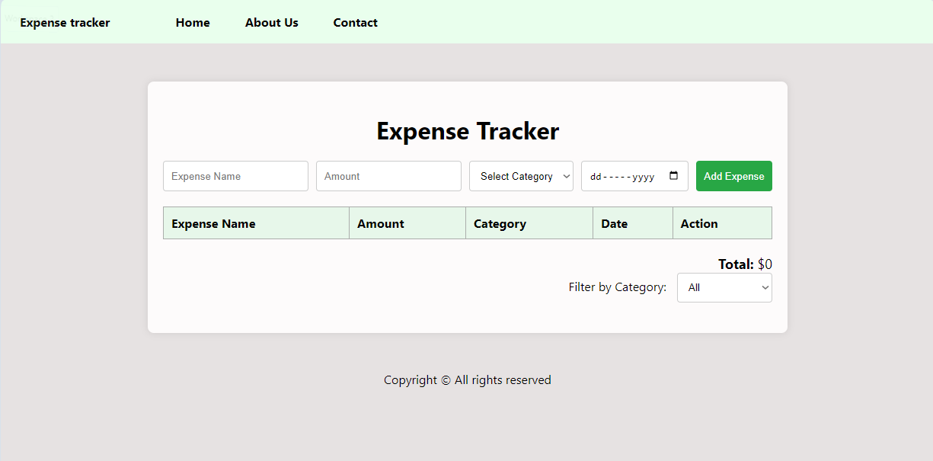
HOME PAGE

Slide 10
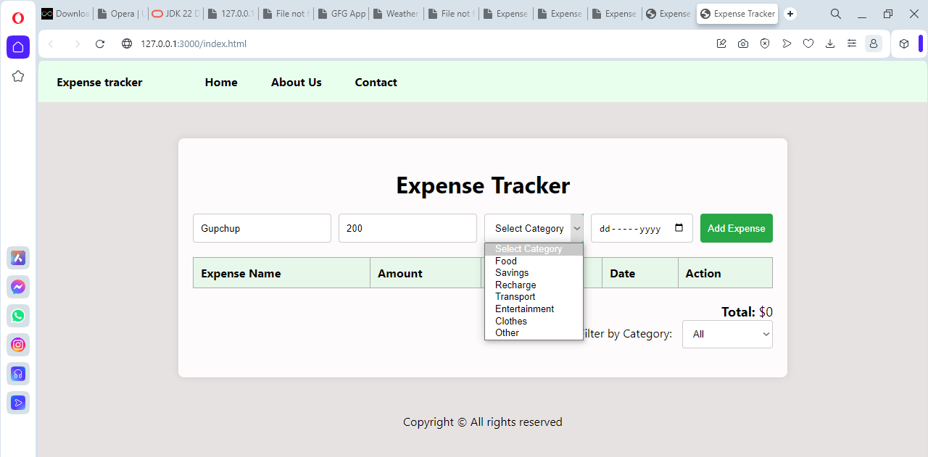
CATEGORY SELECTION

Slide 11
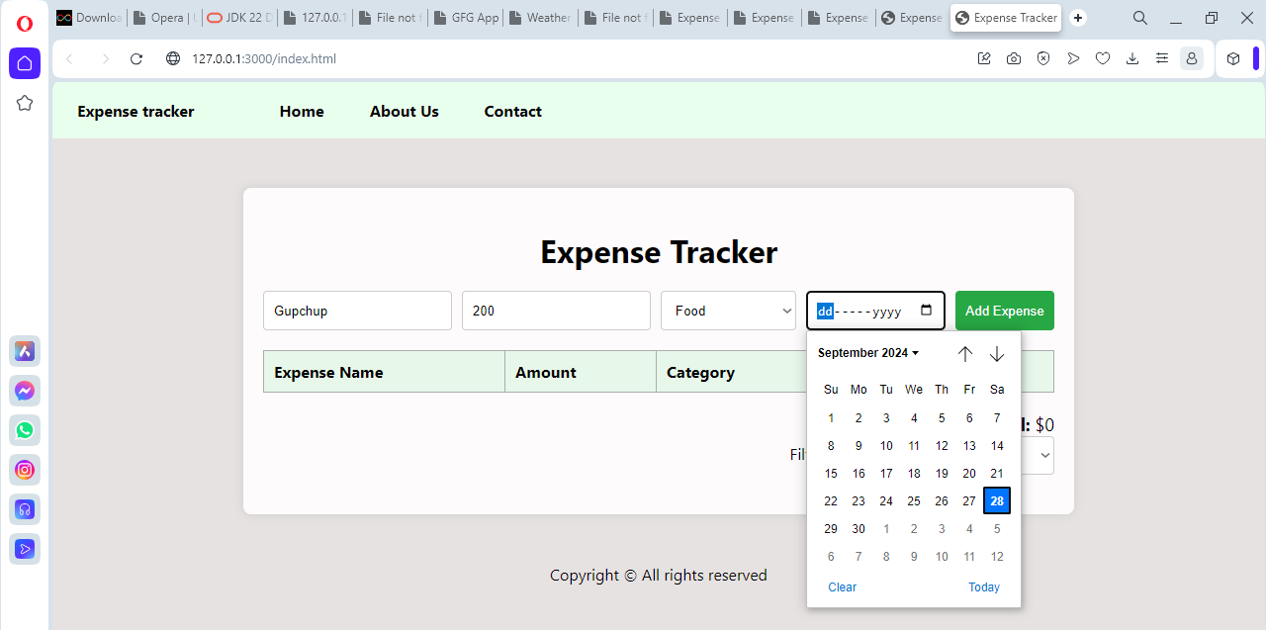
DATE SELECTION

Slide 12
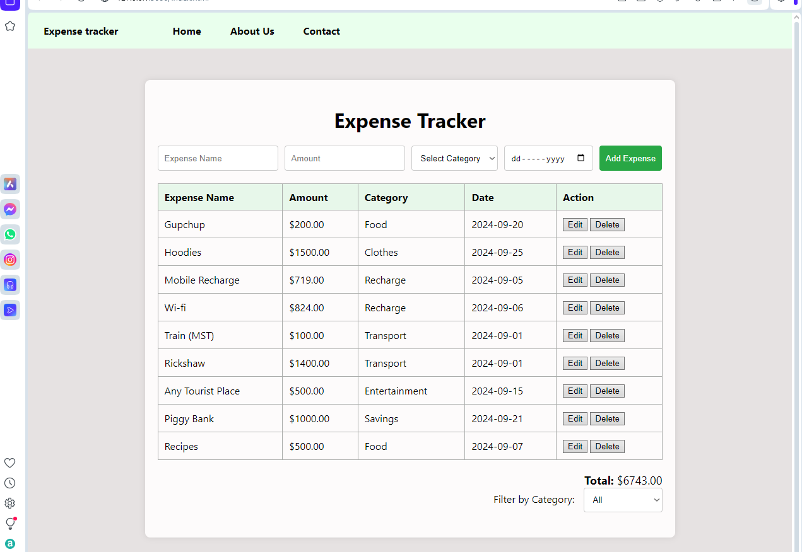
ENTRIES & TOTAL

Slide 13
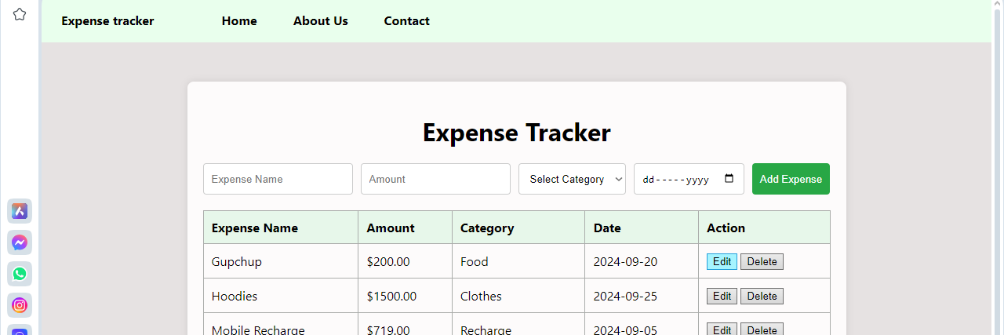
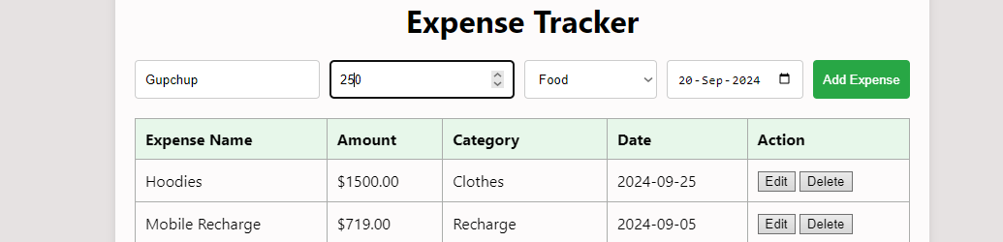
EDIT

Slide 14
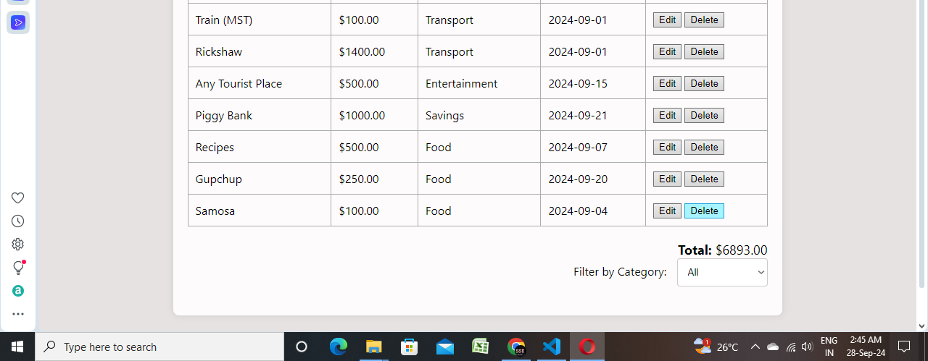
DELETE

Slide 15
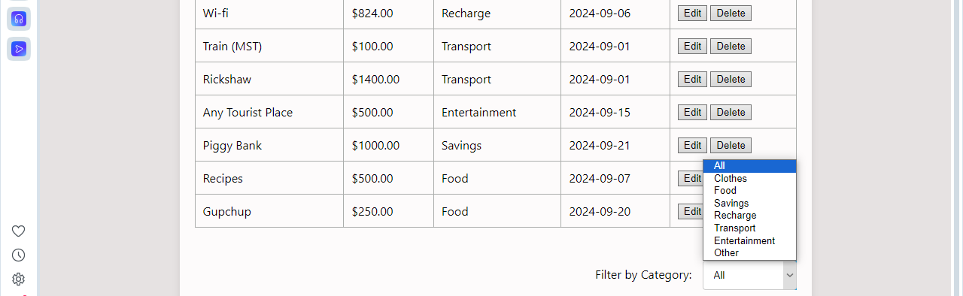
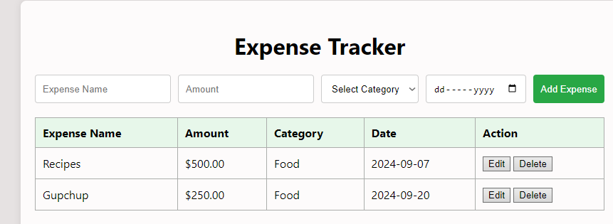
FILTER

Slide 16
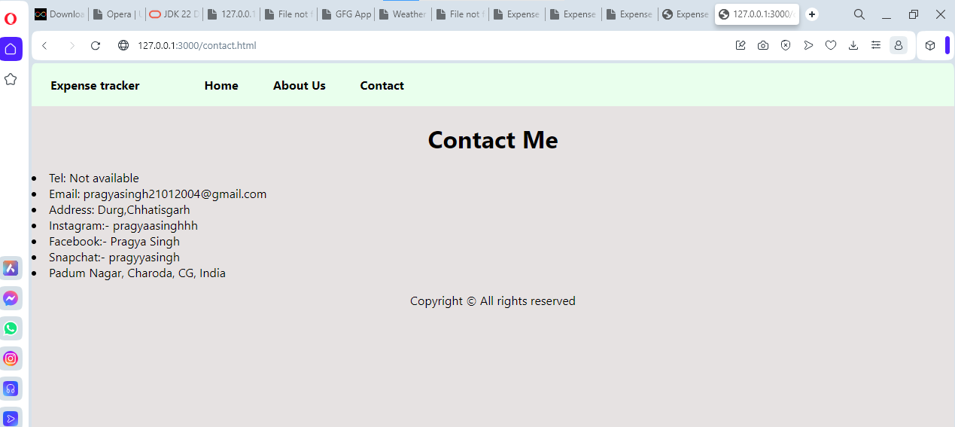
CONTACT PAGE

Slide 17
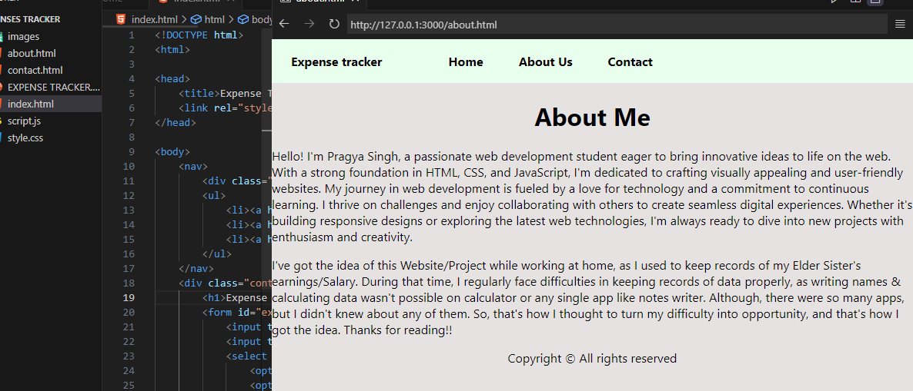
ABOUT PAGE

Slide 18

THANK
YOU

